Slide 4
PAPERWORK
GREEN - CHECKLIST
PALE YELLOW - GROUP BUY FORM
GOLDEN YELLOW- NON-GROUP BUY FORM
NEON YELLOW - SHOW RULES MEDIA RELEASE/ W-9
SALMON/PURPLE - PROJECT CENTER RULES
RED - PROJECT CENTER ADDENDUM
WHITE - EXHIBITOR HANDBOOK
Notes:
HW

Slide 5
ANIMALS IN FFA
Students can choose to raise an animal for the Klein ISD show
Not required for class or to be in FFA
Student required to go to barn twice daily to feed
Fees: Barn, Animal, Food, Shavings, FFA Dues, Official Dress, Etc.
Notes:
HW

Slide 6
IMPORTANT DATES
September 8th, 2023 @ KO: KO FFA Payment Day
Animal Purchase
-September 9th, 2023: 8:00-11:00am (Saturday)
Klein ISD Multipurpose Center
- All group buy payments DUE
-Stududents should plan to stay for AG OLYMPICS
October 4, 2023: Random Draw Generator
October 6th, 2023: All non-group buy payments DUE
October 7, 2023: Selection of Pigs, Lambs, and Goats
Notes:
HW

Slide 7
IMPORTANT DATES
October 18, 2023: Turkey Pick-Up @ KMPC
December 14, 2023: Fryer Rabbit Pick-Up @ KMPC
January (Date TBD): Broiler Pick-up @ KMPC
Notes:
HW

Slide 8
ELIGIBILITY
Exhibitors must:
Be enrolled in an ag class
Pay their FFA dues
Be eligible to show
Attend FFA meetings
Complete Quality Counts
Notes:
JG

Slide 9
FFA OFFICIAL DRESS
ALL students showing in Klein ISD show, must be in official dress:
FFA JACKET: Can be purchased at the Shop FFA website
FFA TIE or SCARF: Can be purchased at the Shop FFA website
BLACK PANTS (black jeans are acceptable)
BLACK SHOES (must be closed toe and heel)
WHITE COLLARED SHIRT
Notes:
JG

Slide 10
GROUP-BUY PROJECTS
Project | Animal Cost | Entry
Swine | $325 | $25
Lamb | $400 | $25
Goat | $650 | $25
Chickens (25 @ $2/bird) | $50 | $10
Turkeys* (5 min) | $7/each | $10
Fryer Rabbits | $240 a pen | $10
Steers | Already purchased | Already Paid
Notes:
JG

Slide 11
NON-GROUP-BUY PROJECTS
Project | Entry Fee
Horticulture | $10
Floral | $35
Breeding Rabbits | $10
Breeding Poultry | $10
Ag Science Fair | $10
Heifer | $25
Ag Mech | $10
Photography | $10
Notes:
JG

Slide 12
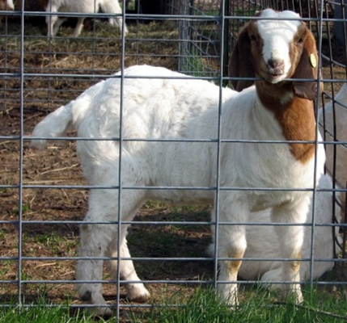
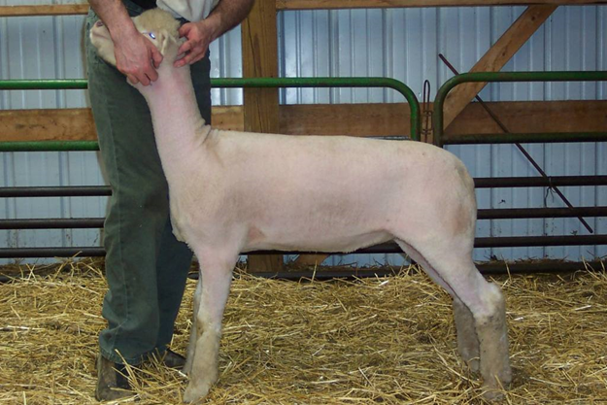
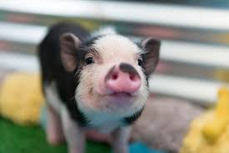
SELECTION
For Pigs/Lambs/Goats:
Selection will take place on October 7, 2023 at the KMPC.
Selection Times (viewing will be approximately ONE hour before selection)
Pigs - 8am
Lambs - 12pm (approximately)
Goats - 2pm (approximately)
Notes:
JG

Slide 13
ON-BARN VS OFF-BARN
Off-Barn Animals: Must be housed within 20 miles
On-Barn animals: Cattle, Swine, Goats, Sheep, Breeding Poultry
Barn Clean-Up - September 27, 2023 at 3:30-5:30pm
On Barn Animal | Barn/Pen Fee
Cattle | Already Paid
Swine | $30
Goat | $25
Sheep | $25
Breeding Poultry | $10
Notes:
JS

Slide 14
BARN POINTS
You will start with 4 barn points.
Failure to abide by the District Barns Rules and Addendum will result in loss of barn points.
Mr. Strickler is the only ag teacher that will assign barn points; however, all ag teachers will work together in assessing violations.
Reaching 0 points will result in removal of all projects from the barn and you will not be allowed at the barn.
Point values will reset back to 4 on April 1, 2024.
Notes:
JS

Slide 15
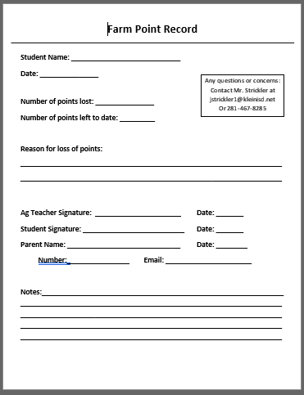
Notes:
JS

Slide 16
HEIFER PROJECTS
Exhibitors may enter & show 1 breeding beef heifer
Must submit copy of registration papers with entry
American or AOB
Notes:
JS

Slide 17
MARKET POULTRY
All market poultry projects are kept at the student’s home
Turkeys will be distributed October 18th, 2023 from 2:30-3:30 @ the KMPC
Broilers will be distributed January 2024 (Date TBD)
-Broilers show 1 pen of 3 birds
Poultry will be winged banded and band must be in place on wing to show. Correct band numbers are mandatory so please keep a record of your band numbers.
Notes:
JS

Slide 18
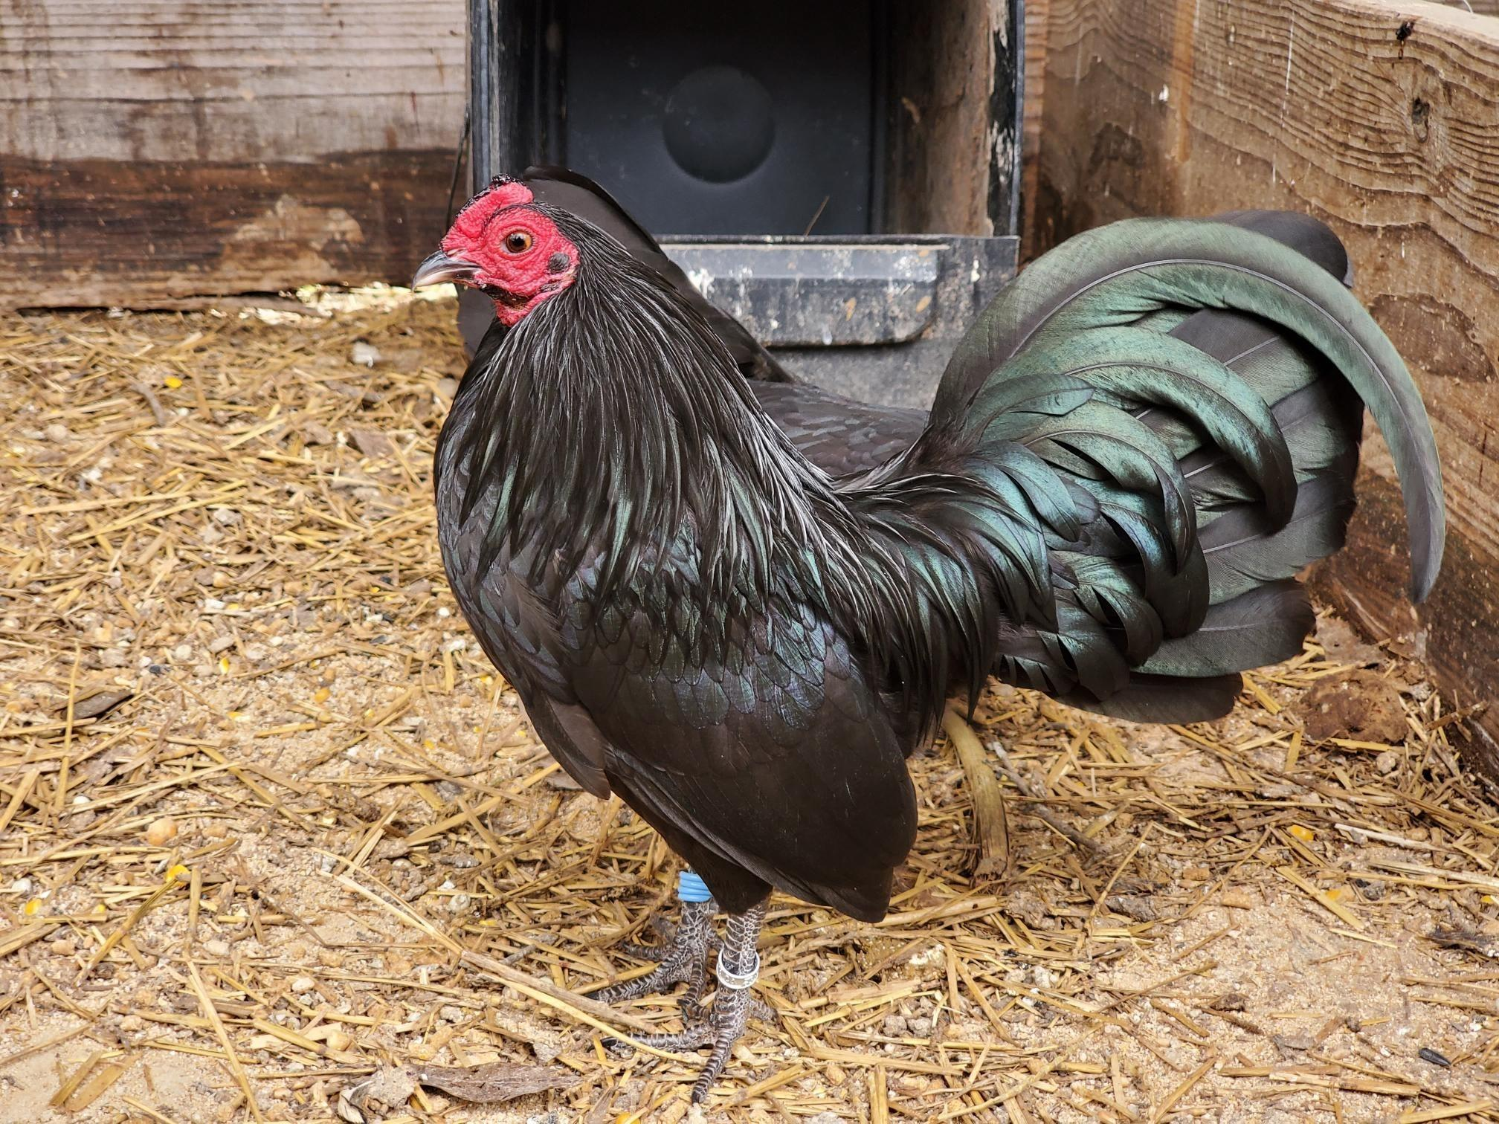
BREEDING POULTRY
$10 each entry Fee, Max of 4 birds
Open to chickens, ducks, and geese
Ownership by required date
Breeding poultry does NOT sell in the auction
Please see show rules for more details
Notes:
JS

Slide 19
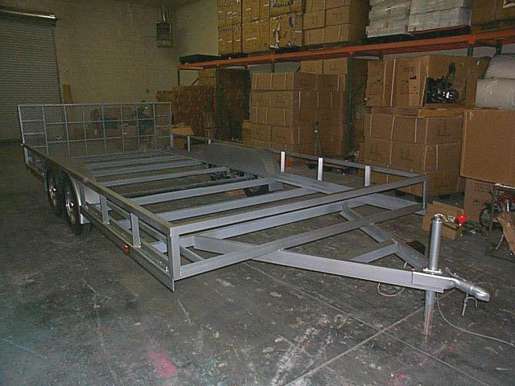
AG MECHANICS
9 Different Divisions
Individual/ Group
AG Mech items do not sell in auction
Notes:
JS

Slide 20
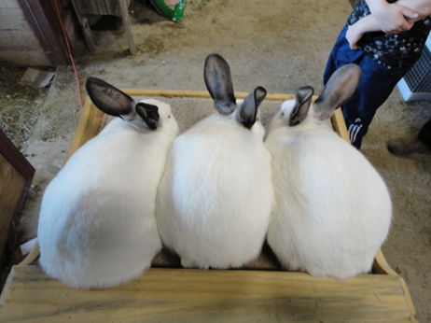
FRYER RABBITS
All rabbit projects are kept at the student’s home.
Rabbits will be distributed December 14, 2023 from 2:30-4:00 pm @ the KMPC
Show 3 of 4 Rabbits
Can enter 4th rabbit as breeder for an additional $10 entry fee (optional)
Notes:
JR

Slide 21
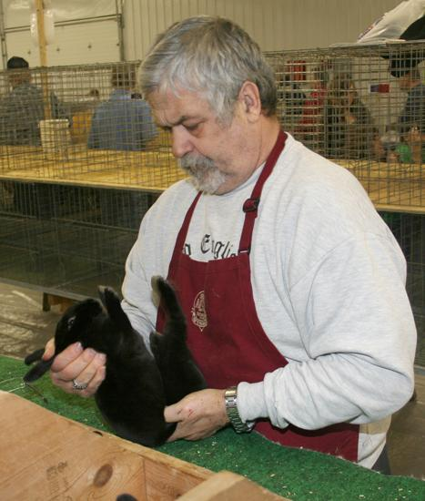
BREEDING RABBITS
All rabbit projects are kept at the student’s home.
Classes: Junior, Intermediate [*NEW addition this year!] and Senior Divisions
Allowed to show any buck or doe in above categories
May only show 1 rabbit per division
Ownership by required date (see Mrs. Roos)
Breeding rabbits do NOT sell in the auction
Notes:
JR

Slide 22
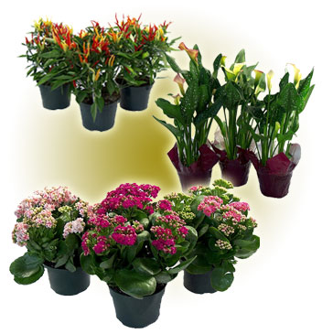
HORTICULTURE
All projects must be property of the exhibitor and started no later than November 1, 2023
Only 1 entry per division.
Entry Fee $10 each
Top 7 overall sell at auction- other entries may sell in Tent Sale.
Each entry must have a portfolio.
Notes:
JG

Slide 23
AGRISCIENCE FAIR
Individual student projects, no group projects
One Entry per student
7 minute presentation, display and written report
1st through 10th receive ribbons
Grand Champion receive belt buckles and trophy
Reserve Champion receives belt buckles
Notes:
JG

Slide 24
FLORAL DESIGN COMPETITION
Must be in or have taken Floral Design
Arrangements placing 1st through 5th will be eligible for auction
All other arrangements may be sold in the tent sale
Official Dress is required, FFA jacket is not
Notes:
MK

Slide 25
PHOTOGRAPHY
Theme: Weights & Measures
One Entry Per Student - Entry Fee is $10.
Entries will be eligible to be sold in Freezer Sale only.
The top ten projects will receive ribbons. Grand Champion overall will receive a belt buckle, trophy, and Klein FFA Alumni Sponsored Scholarship. Reserve overall will receive a buckle.
Notes:
MK

Slide 26
AUCTION
Large animals:
Steers
Top 11 in auction
Pigs
Top 32 in auction
Lambs
Top 12 in auction
Goats
Top 12 in auction
Small Animals:
Turkeys
Top 10 in auction
Broilers
Top 10 pens in auction
Fryers
Top 10 pens in auction
Notes:
MK

Slide 27
AUCTION
Additional items
Horticulture:
Top 7 in auction
Floral Design:
Top 5 in auction
Showmanship Winners:
Showmanship winners will sell in the auction
Student may sell up to 3 items in auction. Grand & Reserve items will sell at auction
Notes:
MK

Slide 28
PRE-SALE BUYERS
All exhibitors are encouraged to have a pre-sale buyer for each large animal project shown.
Locate a “buyer” for your animal
Local business, family members, friends
Guarantees purchase of your project…if you don’t make auction
Suggested purchase amounts are indicated on the form
Notes:
MK

Slide 29
PRE-SALE BUYERS
All exhibitors are encouraged to have a pre-sale buyer for each large animal project shown.
Pre-Sale Amounts:
Steer $3,000.00
Swine $400.00
Lamb $500.00
Goat $750.00
Turkey $150.00
Fryer $300.00
Broiler $150.00
Horticulture $50.00
Photography $50.00
Options for animal after purchase…
Send to processor
Donate to charity
Donate to chapter
Take them home
Notes:
MK

Slide 30
REQUIRED FORMS & PAYMENTS (GREEN CHECKLIST)
Klein Show Animal
Animal Purchase Payment
Cashiers Check, OR Money Order
Make Payable to Klein ISD Show Association
Animal Purchase Form- PALE YELLOW PAPER
Show Rules/Media Release & W-9- NEON YELLOW PAPER
Barn Animals
Barn Fees Paid
Personal Check, Money Order, Cashiers check, Cash
Barn Card
Please bring existing barn cards with you
Barn Rules- SALMON OR PURPLE PAPER
EVERYONE WILL TURN IN A BARN RULES AGREEMENT FORM. Even Off-Barn for contact information for parent and student.
Notes:
JR

Slide 31
Notes:
JR

Slide 32
Notes:
JR

Slide 33
REMIND GROUP CODES
TEXT CODE TO 81010
STEERS: @kisdsteers HEIFERS:@KOheif
LAMBS: @kolam23
GOATS: @kogoat24
PIGS: @kisdpigs24
TURKEYS: @koturkey BROILERS:@kobroiler
BREEDING POULTRY: @koclucker
RABBITS: @korabbi
Notes:
JR

Slide 34
REMIND GROUP CODES
TEXT CODE TO 81010
HORTICULTURE: @kohort24
AG SCIENCE FAIR: @kosci24
FLORAL CONTEST: @kisdfloral
PHOTOGRAPHY: @kisdphoto
Notes:
JR

Slide 35
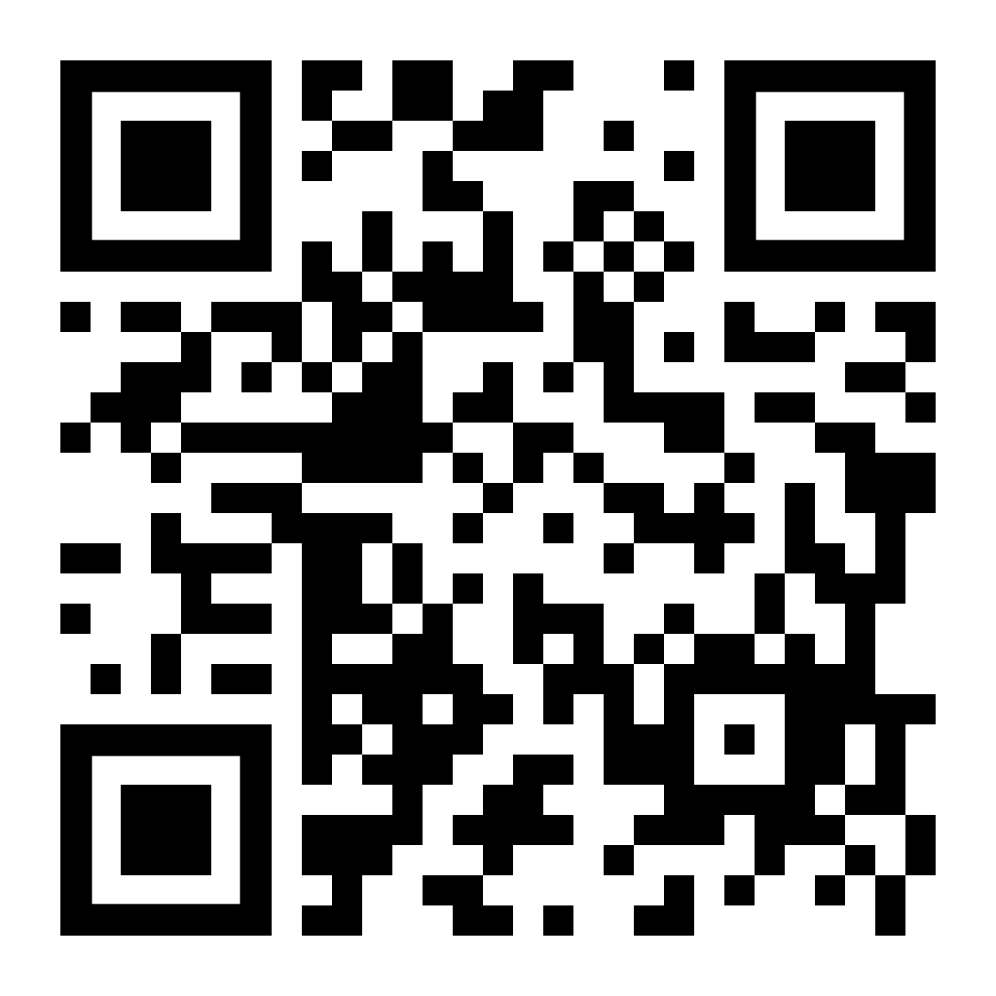
ATTENDANCE FORM! MUST FILL OUT TO GET CREDIT FOR BEING HERE!
Notes:
JR

